Slide 1
Ferns N Petals Sales Analysis Dashboard
The aim of this analysis is to study the overall sales performance,
revenue distribution, and customer trends based on various
dimensions like category, occasion, and location.

Slide 2
Problem Statements:
The management seeks to understand the key factors influencing total sales and revenue performance.
They want to identify which product categories, occasions, and locations contribute most to revenue and analyze delivery lag patterns and customer demographics.
Objectives:
• Assess Financial Health: Monitor total orders, revenue, and average earnings.
• Highlight Top Products: Identify highest-earning product categories.
• Track Seasonal Patterns: Analyze monthly revenue fluctuations.
• Spot Key Sales Drivers: Find holidays or events with peak sales.
• Find High-Value Markets: Identify top-performing
cities.

Slide 3
Dataset Description
Dashboard Overview
Total Orders: 1000
Total Revenue: ₹35,20,984
Average Customer’s Spent: ₹3,521
Average Order to Delivery Time: 5.53 days
The dataset includes fields such as Order Date, Product Category, Occasion, City, Gender, Quantity, and Revenue.
The dashboard provides visual insights into FNP sales performance across categories, months, and customer segments. Key visual components include:
Revenue by Category
Top Locations by Revenue
Monthly Revenue Trends
Revenue per Occasion
Interactive Filters for Month and Occasion

Slide 4
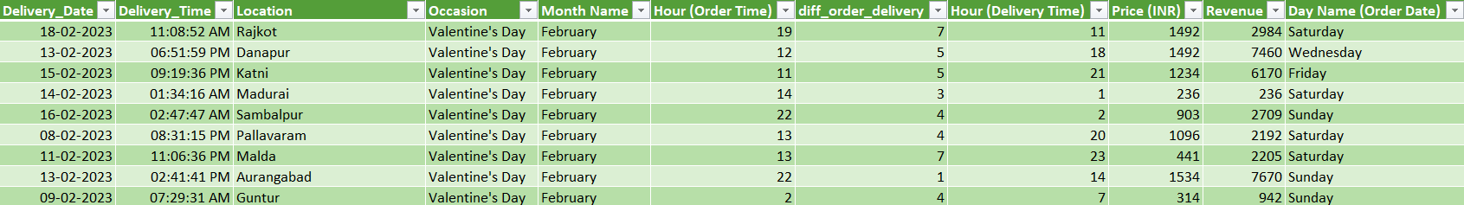
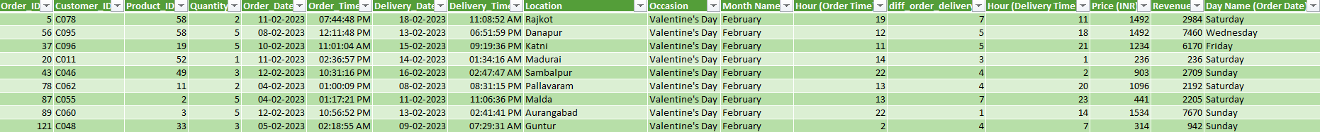
DATA CLEANING
Made proper date and time format for improper format.
Deleted repeated orders.
Combined orders data in the existing dataset.
Made necessary formatting in the range for better analysis.

Slide 5
KEY METRICS
Metrics | Values | Easy Insights
Total Orders | 1000 | The company handles exactly 1000 sales.
Total Revenue | ₹35,20,984 | The business is bringing in over ₹35 lakhs.
Avg. Customer’s Spent | ₹3,521 | The average value of each order is about ₹3500.
Avg. Order-Delivery Time | 5.53 days | Orders take almost a week to be delivered, on average.

Slide 6
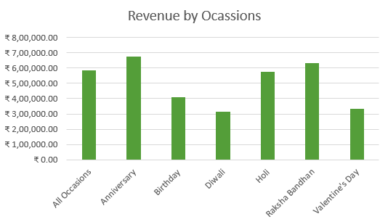
OCCASION BY REVENUE
Observations | Key Insights
Anniversary and Raksha Bandhan generate the highest revenue (≥₹6.3 lakhs each). | Relationship Focus: These deep, personal relationship occasions are the most financially rewarding. Target them heavily for predictable returns.
Valentine's Day revenue is only moderate (₹3.3 lakhs), despite February's high overall monthly sales. | High Value Orders: Anniversary/Raksha Bandhan likely feature much higher priced gifts (higher Average Order Value) than the typical Valentine's Day purchase.

Slide 7
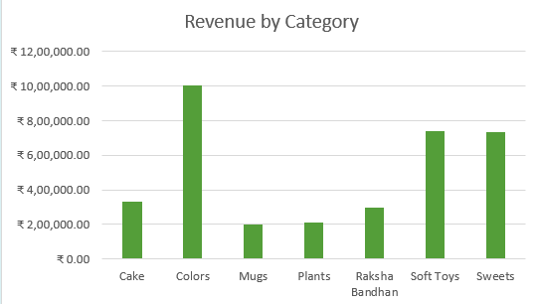
REVENUE BY CATEGORY
Observations | Key Insights
Colors is the clear leader, generating approximately ₹10,00,000. | Primary Focus: Maximize inventory and profit margins for "Colors" (e.g., flowers), as this is the company's core revenue stream.
Soft Toys and Sweets follow, both earning over ₹7,00,000. | Cross-Selling Potential: Use Sweets and Soft Toys to create attractive gift bundles with Colors, boosting the average order value.
Mugs and Plants are the bottom categories, each generating only about ₹2,00,000. | Strategic Review: Investigate why sales are low for these items (marketing, demand, or price) before deciding to scale back or redesign the offerings.

Slide 8
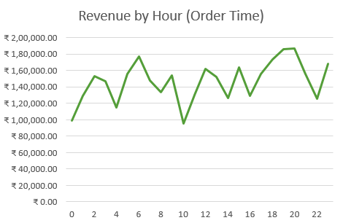
REVENUE BY ORDER TIME
Observations | Key Insights
Revenue peaks sharply in the evening between 19:00 and 20:00 (7 PM – 8 PM), nearly reaching ₹1,90,000. | Evening Core Market: The sustained climb from 16:00 to 20:00 indicates that the evening hours are your primary revenue drivers, likely due to post-work consumer activity.
The most significant drop occurs at 10:00 (10 AM), representing the lowest revenue point in the entire 24-hour cycle. | Operational Gap: The 10 AM slump highlights a major underutilized window; targeted morning promotions could help stabilize revenue during this period.
There is an unexpected surge in activity at 06:00 (6 AM) before a steep decline leading into mid-morning. | Afternoon Instability: Frequent fluctuations between 12:00 and 16:00 suggest inconsistent demand, which may require better staffing adjustments to handle the rapid "peaks and valleys."

Slide 9
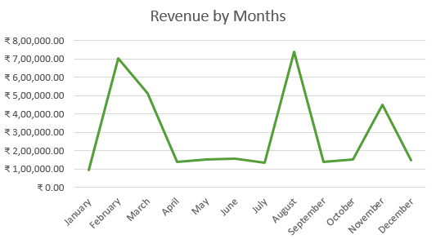
REVENUE BY MONTH
Observation | Key Insights
Dramatic Peaks: Revenue hits its highest points in August and February, showing extreme seasonal spikes. | Seasonality: The business likely relies on bi-annual events or promotions, as most months show minimal growth compared to the two major peaks.
Low-Growth Plateaus: A significant "flat" period occurs between April and July, where revenue stays consistently low. | Resource Strain: The massive jumps (e.g., July to August) suggest a need for high operational flexibility to handle sudden 5x increases in volume.
Year-End Volatility: There is a sharp recovery in November followed by a sudden drop in December. | Resource Strain: The massive jumps (e.g., July to August) suggest a need for high operational flexibility to handle sudden 5x increases in volume.

Slide 10
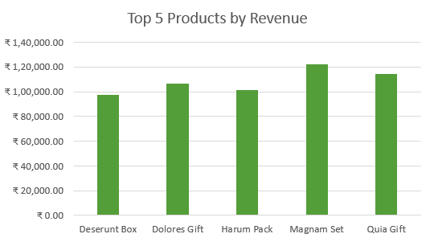
TOP PRODUCTS BY REVENUE
Observations | Key Insights
Top Performer: Magnam Set leads the group, generating the highest revenue at over ₹1,20,000. | Gift-Centric Demand: Most top products are "Gifts," "Sets," or "Packs," indicating customers prefer bundled offerings.
Tight Competition: All top five products perform within a narrow range between ₹95,000 and ₹1,25,000. | Revenue Stability: Sales are evenly distributed across these top items, reducing the risk of relying on a single product.

Slide 11
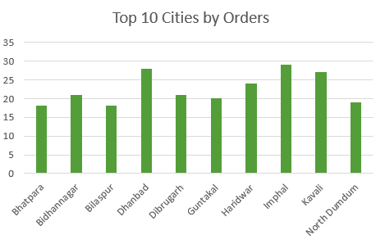
TOP CITIES BY ORDERS
Observations | Key Insights
Top Performer: Imphal leads the group with the highest volume (approx. 29 orders), followed closely by Dhanbad. | Regional Strength: High performance in cities like Imphal and Dhanbad suggests strong logistics or brand awareness in non-metro regional hubs.
Performance Floor: The lowest volume is roughly 18 orders (Bhatpara and Bilaspur), showing a narrow gap of only ~11 orders between the top and bottom of this list. | Consistency Opportunity: Most cities hover between 18–21 orders; a minor localized campaign could easily push these "stable" performers into the high-growth bracket seen by the top three.

Slide 12
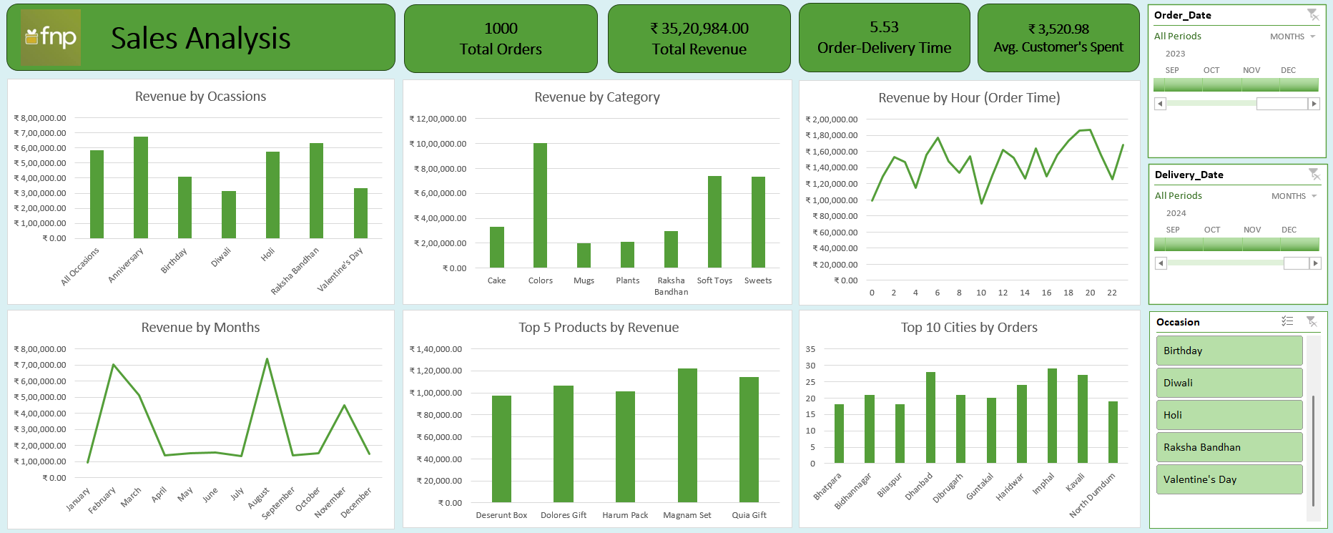
DASHBOARD

Slide 13
SUMMARY BY FINDINGS
Financial Overview: Total revenue stands at ₹35,20,984 from 1,000 orders, with an average customer spend of ₹3,520.98.
Peak Seasons: Sales spike significantly in February (Valentine's Day) and August (Raksha Bandhan), which are the two highest-earning months and occasions.
Top Category: "Colors" is the clear leader in revenue generation, significantly outperforming other categories like Soft Toys, Sweets, and Cakes.
Hourly Trends: Ordering activity is highest in the late evening, specifically peaking around 8:00 PM (20:00).
Operational Efficiency: The average order-to-delivery time is 5.53 days, while Imphal and Dhanbad lead as the top cities by order volume.

Slide 14
CONCLUSION & SUGGESTION
Diversify Category Focus: While "Colors" is the top revenue generator, Mugs and Plants are underperforming; consider bundling these slow-moving items with top-sellers to clear inventory and balance revenue.
Optimize Ad Spend: Peak ordering occurs at 8:00 PM and during February/August; shift marketing budgets to these specific windows to maximize ROI and capture high-intent traffic.
Improve Delivery Speed: An average delivery time of 5.53 days is relatively high for gifting; streamlining logistics in high-volume hubs like Imphal and Dhanbad could increase repeat purchase rates.
Target Mid-Tier Occasions: Diwali and Valentine’s Day show lower revenue than Anniversary/Raksha Bandhan; launching targeted "Early Bird" promotions for these specific occasions could help bridge the revenue gap.

Slide 15
THANK YOU

